Slide 1


CP301 : Development Engineering Project
Under the guidance of
Dr. Lipika Kabiraj Assistant Professor, IIT Ropar
Presented by-
Priyanshu Gupta (2022MEB1330)

Slide 2
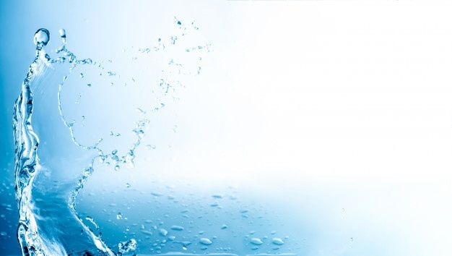
Title of Project : Hybrid Atomizer for shear-thinning fluids

Slide 3
1. Introduction
Atomization is widely observed in nature (e.g., rain, ocean waves) and is a frequent phenomenon in industries (e.g., agriculture, pharmacy, propulsion).
The size distribution of droplets from atomization is very critical for the combustion of liquid fuels and other applications.
Liquid propellants/fuels have advantages like controlled throttling, ease of atomization, but lack safety.
Gel propellants offer safety while handling and ease of atomization by using liquid propellant atomizers like impinging jets, pressure-swirl, and air-blast atomizers.
Gel propellants are non-Newtonian, shear-thinning, and yield stress fluids.
Atomization of gel propellants requires application of high shear rates, which is a challenge.

Slide 4
2. Background and Theory
Atomization and Pressure-swirl Atomizer
Atomization is a process of disintegrating a bulk liquid into fine droplets, enhancing surface area . Various atomization technique such as pressure-swirl, airblast, ultrasonic and elctrostatic methods.
The pressure-swirl atomizer imparts angular momentum to the liquid, forming a hollow cone spray.
Evolution of Atomization Technology
The 19th century marked the advent of mechanical atomizers, notably in combustion engines.
In 21st century, precise atomizers are needed in the fields like pharmaceuticals and additive manufacturing.
Spray Dynamics and Measurement Technique.
Stages of atomization – liquid sheet formation, breakup into ligaments and finally droplet formation
High speed imaging, laser diagnostics and computational fluid dynamics simulations can be employed to characterize sprays.
Shear Thinning fluids
Shear thinning fluids exhibits a decrease in viscosity with increasing shear rate.
Discharge Coefficient
It is a dimensionless parameter evaluating the efficiency of fluid flow through the orifice.
C_{d}= Q_{actual}/Q_{ideal}

Slide 5
3. Problem statement
Efficient atomization of shear-thinning liquids like Carbopol gels is challenging due to their high viscosity and yield stress¹ .
Existing pressure-swirl atomizers are optimized for Newtonian fluids like water, but their performance with non-Newtonian fluids is not well understood².
This study aims to compare the spray behavior of water and Carbopol gels under varying injection pressures (1–8 bar), and study spray characteristics:
(a) Breakup length | (d) Discharge coefficient
(b) Spray cone angle | (e) Droplet size distribution
(c) Mass flow rate
¹Natan B and Rahimi 2010
² Brenn et al. 2010

Slide 6
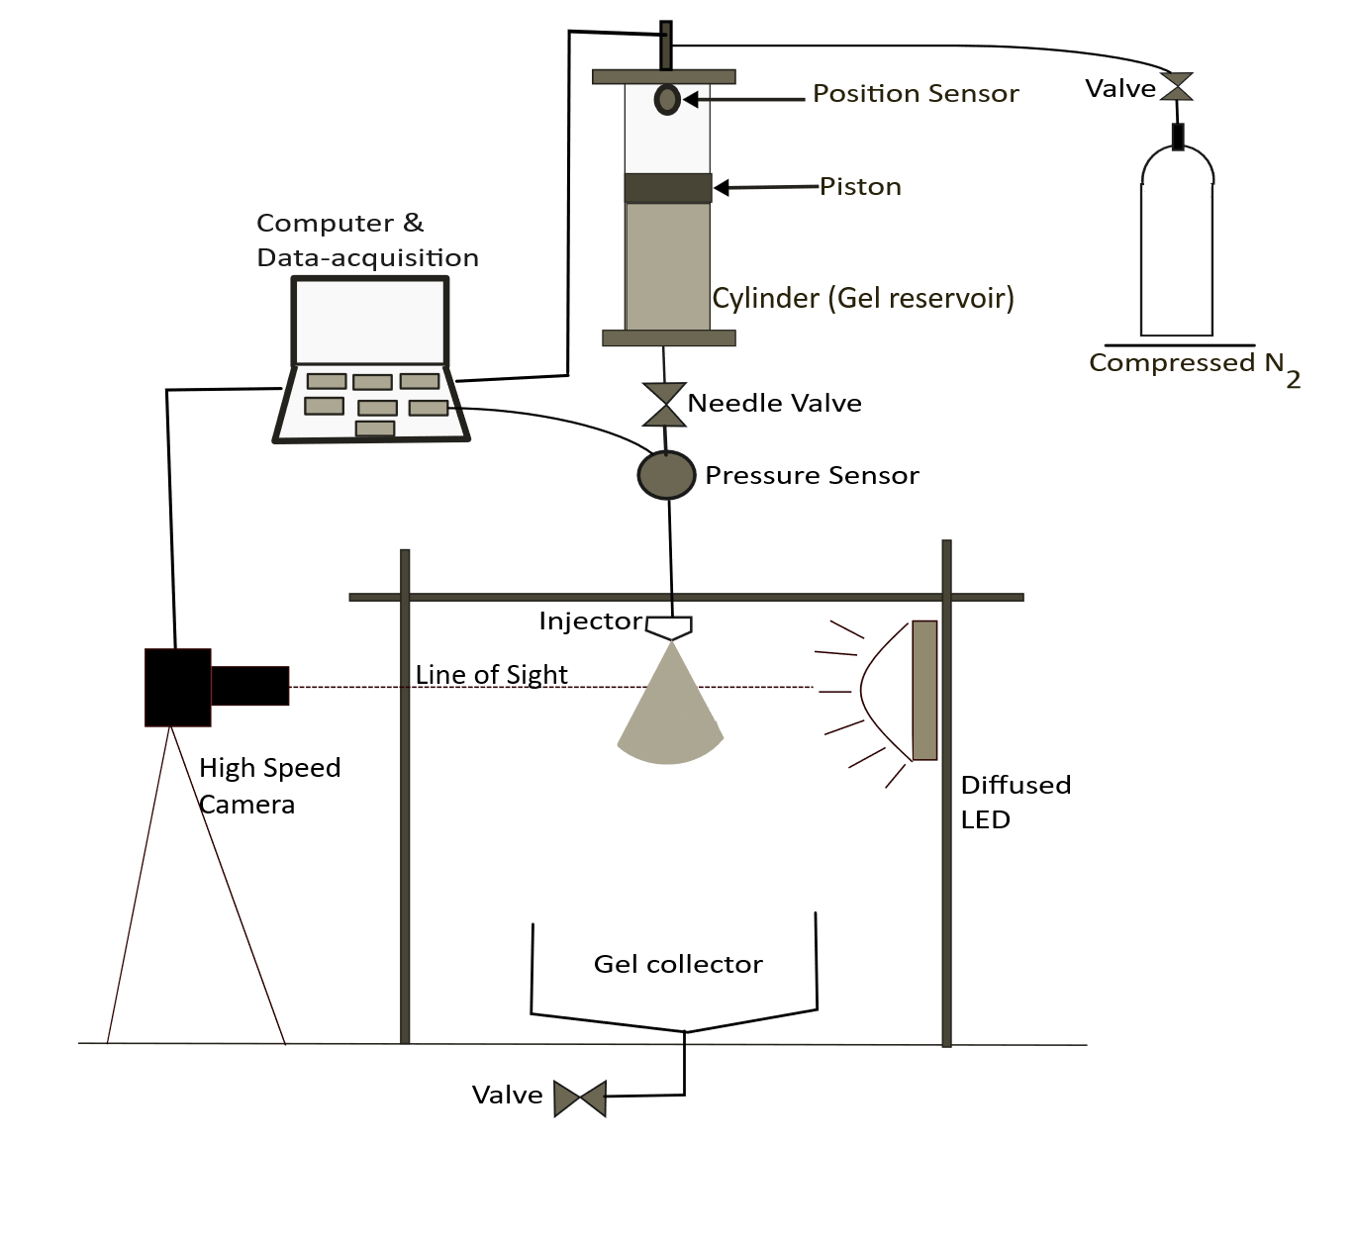
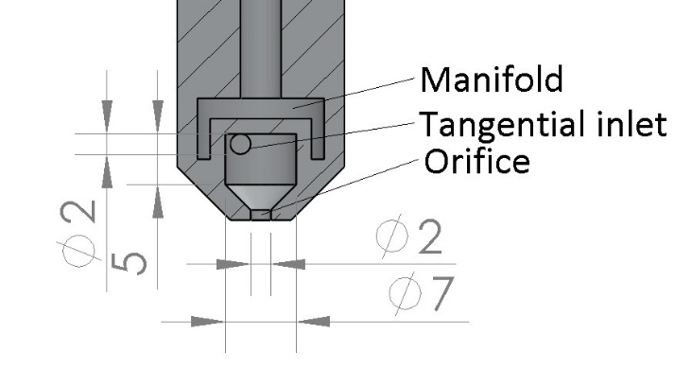
4. Methodology
Atomizer Configuration
Pressure-swirl atomizer with twin tangential inlets.
Forms hollow cone spray.
Test Rig & Fluid Delivery
Cylindrical liquid reservoir with a piston
Pressure sensor at nozzle inlet
Piston position sensor to calculate the mass flow rate of liquid.
Test Fluids:
Water and Carbopol gels (0.10 wt.% and 0.35 wt.%)
The viscosity-shear rate measured by the Anton Paar MCR 101 rheometer.

Slide 7
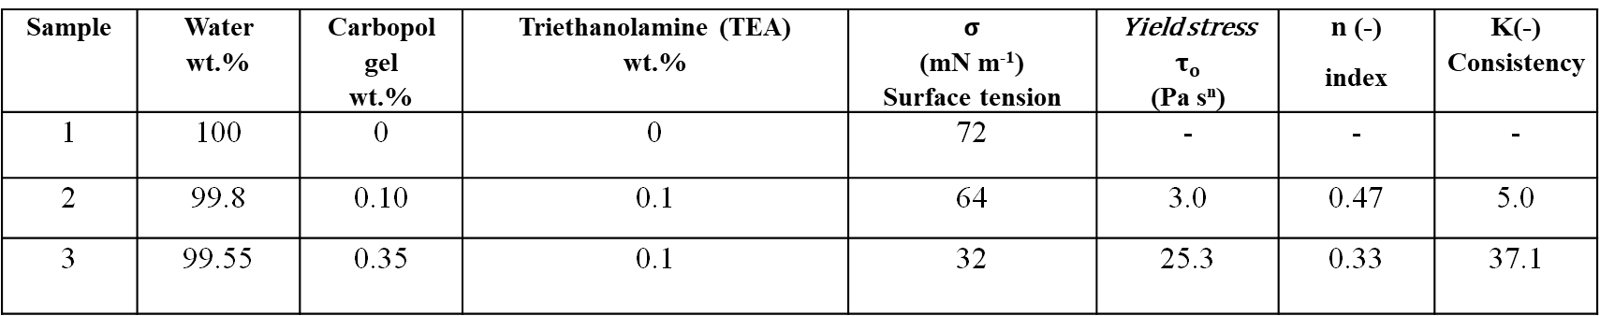
Gel Composition
Sample | Water wt.% | Carbopol gel wt.% | Triethanolamine (TEA) wt.% | $σ$ (mN m⁻¹) Surface tension | Yield stress $τ_{o}$ (Pa s^{n}) | $n$ (-) index | K(-) Consistency
1 | 100 | 0 | 0 | 72 | - | - | -
2 | 99.8 | 0.10 | 0.1 | 64 | 3.0 | 0.47 | 5.0
3 | 99.55 | 0.35 | 0.1 | 32 | 25.3 | 0.33 | 37.1
Table . Rheological properties of test gels used.
Spray Diagnostics
High-speed spray visualization at 4000 fps with 5 μs exposure time,
150W LED and shadowgraph technique.
A spatial resolution of 70 μm/px.
Droplet sizing was conducted using a long-distance microscope.
5 μm spatial resolution at an axial distance of 70 mm
Radial locations at offsets of 10–40 mm from the nozzle axis.
Measurements ROI-- 3.68 mm X 3.68 mm windows.

Slide 8
Results and discussion

Slide 9
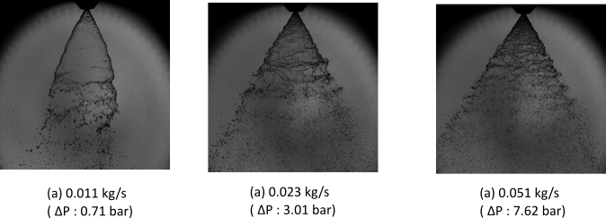
Spray Behavior
Fig. Spray images of water under different mass flow rates.
Water forms a stable hollow cone spray at low pressure, with delayed breakup.
Increasing pressure shifts the breakup point closer to the nozzle and produces finer droplets

Slide 10
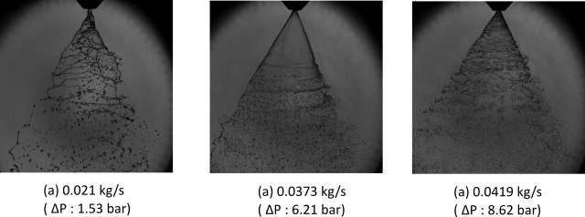
Spray images of Carbopol gel 0.10% wt. at different mass flow rates
At low pressure, the spray forms twisted ribbons and long ligaments, showing delayed breakup and resistance to atomization.
Higher pressure improves spray shape, but the core remains dense with a longer breakup length than water.

Slide 11
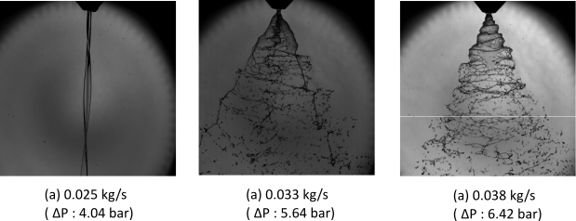
Spray images of Carbopol gel 0.35% wt. At different mass flow rates.
At low pressure, the gel exits as a thin filament with no visible spray cone, indicating severe resistance to atomization
At higher pressures, a cone forms but is dominated by thick, web-like ligaments and poor droplet breakup

Slide 12
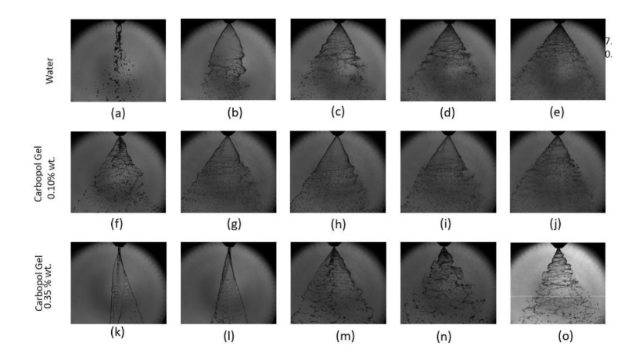
0.25 bar 0.006 kg/s
0.71 bar 0.011 kg/s
1.53 bar 0.017 kg/s
3.01 bar 0.023 kg/s
7.62 bar 0.051 kg/s
Water
1.53 bar 0.021 kg/s
3.41 bar 0.022 kg/s
5.57 bar 0.036 kg/s
7.08 bar 0.038 kg/s
8.62 bar 0.041 kg/s
Carbopol gel 0.10 wt.%
4.46 bar 0.029 kg/s
4.75 bar 0.031 kg/s
5.65 bar 0.033 kg/s
5.72 bar 0.034 kg/s
6.42 bar 0.038 kg/s
Carbopol gel 0.35 wt.%
Figure Spray images of (a–e) Water, (f–j) 0.10 wt.% Carbopol gel, and (k–o) 0.35 wt.%. Carbopol gel at various injection pressures (ΔP) and mass flow rates.

Slide 13
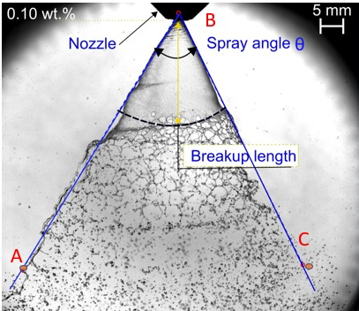
Spray Angle and breakup length
The breakup length is the distance from the nozzle tip to the point where the web like ligaments appear.
The spray angle is the full angle of the liquid filming forming the cone shape.
Measured using Matlab software from averaging 50 images .
Definition of spray angle and breakup length

Slide 14
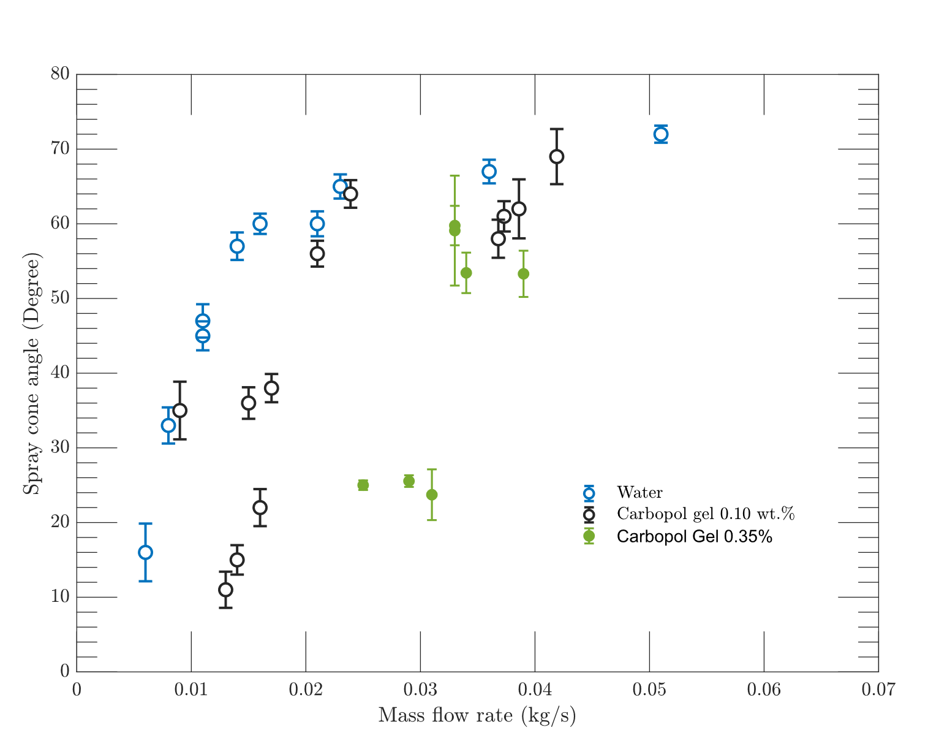
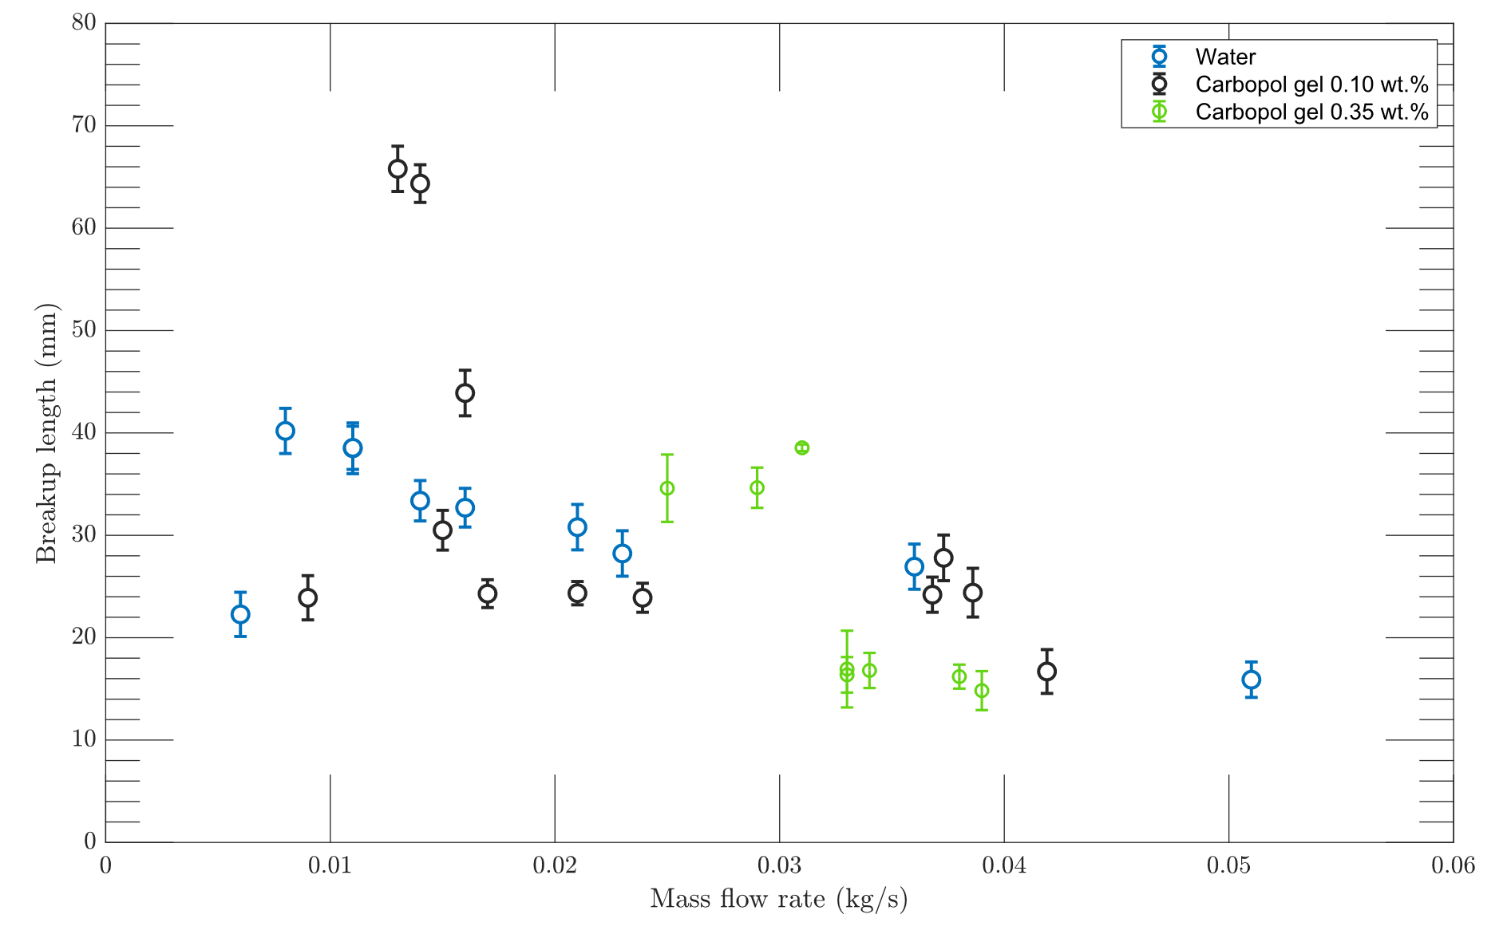
Breakup length and Spray Angle
Breakup length with respect to mass flow rate
Spray cone angle vs mass flow rate of the liquid
Breakup length of water generally decreases with increasing mass flow rates. 0.10% and 0.35% gel has higher breakup length due to yield stress effects.
Water shows higher spray cone angle. 0.35% wt. Gel has significantly narrower cone angles due to its high yield stress.

Slide 15
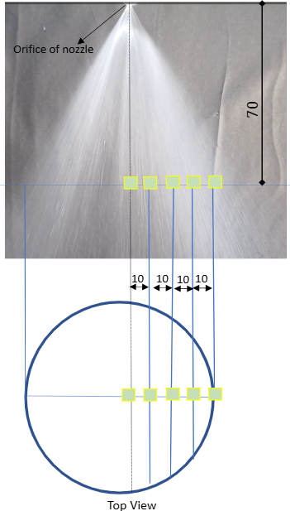
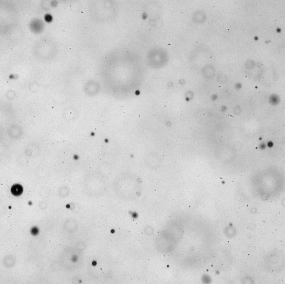
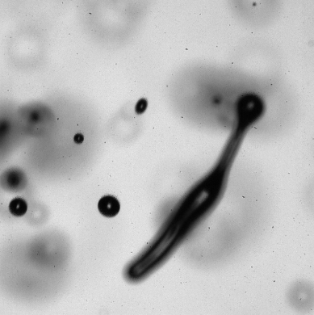
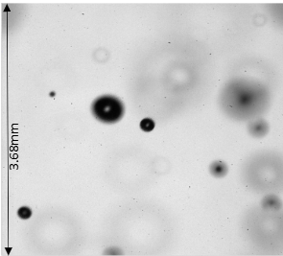
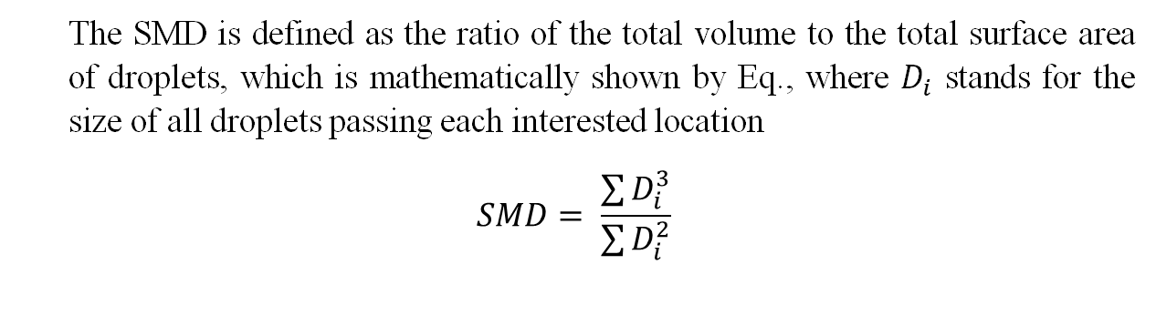
Effect of liquid composition on droplets
The SMD is defined as the ratio of the total volume to the total surface area of droplets, which is mathematically shown by Eq., where $D_{i}$ stands for the size of all droplets passing each interested location
$$SMD= \frac{\sum{D_{i}^{3}}}{\sum{D_{i}^{2}}}$$
(a) (b) (c)
Figure 14. Images of droplets region (3.68 mm ×3.68 mm) captured using high speed camera and LDM. (a) - Carbopol gel 0.10 wt.% at 6 bar injection pressure. (b)- Carbopol gel 0.10 wt.% at 4 bar injection pressure (c) - Water at 6 bar injection pressure.
Radial locations of the interested region where the drop sizing was performed. All dimensions in mm.

Slide 16
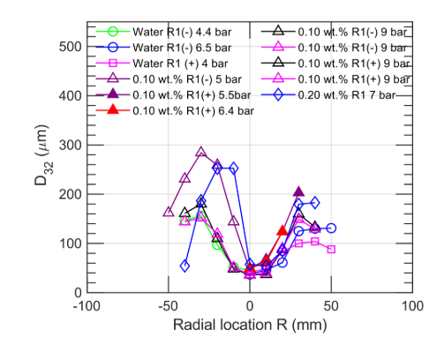
Effect of liquid composition on droplets
D₃₂ for water and different Carbopol gels.
Across all cases, the droplet size is smallest at the spray center (R = 0 mm).
D₃₂ increases toward the edges.
The core receives the highest shear, leading to finer atomization.
Drop sizing across the width of the spray for various flow rates locations for the spray

Slide 17
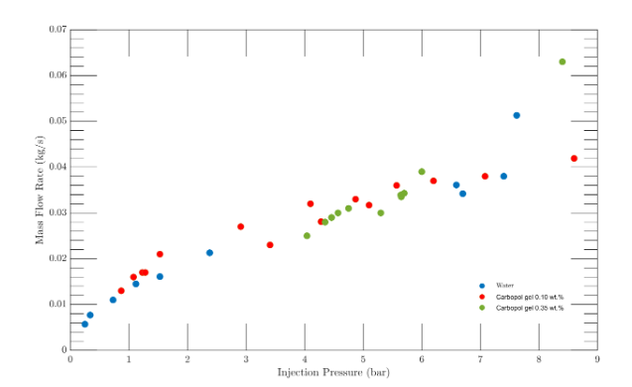
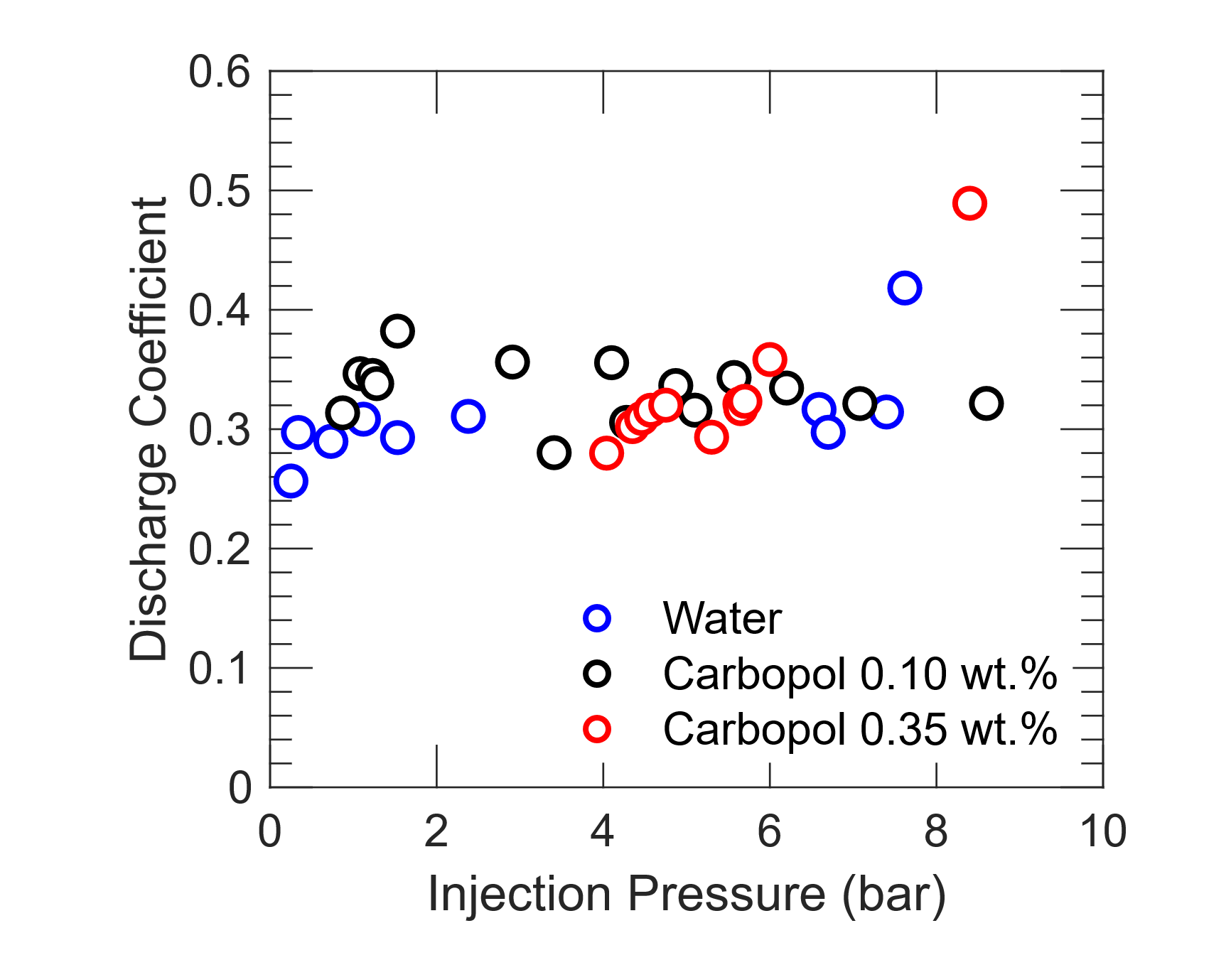
Mass flow rate and Discharge Coefficient
Mass flow rate of the sample liquid with respect to injection pressure
Discharge Coefficient of the sample liquid with respect to injection pressure

Slide 18
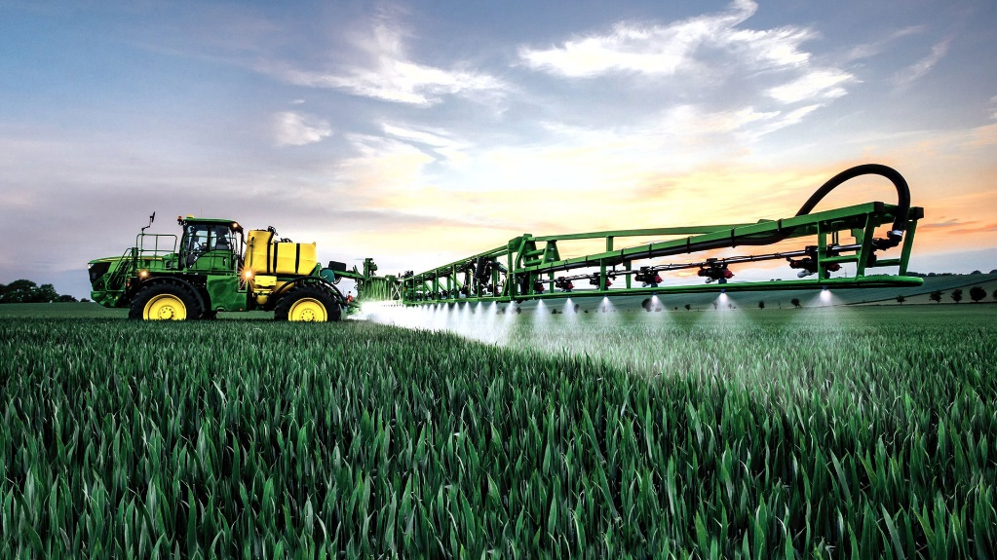
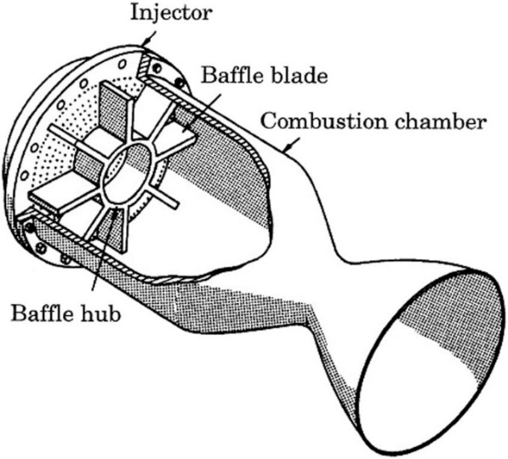
Application
Combustion and Propulsion: Used in aerospace engines and gas turbines for efficient fuel-air mixing and improved combustion performance.
Spray-Based Delivery: Widely applied in pharmaceuticals, agriculture, and food processing for uniform droplet formation in sprays and drying systems.
Safety Systems: Employed in fire suppression systems to disperse extinguishing agents effectively through fine, hollow-cone sprays.
Liquid propellant rocket engine with injector face baffles.
Pressure-swirl nozzles ensure fine droplet formation and even coverage, making them ideal for large-scale farming operations. (Credit: John Deere)

Slide 19
Conclusion
Spray Pattern & Breakup Water forms a stable hollow cone with early breakup and fine droplets. Carbopol gels (esp. 0.35 wt.%) show delayed breakup, thicker ligaments, and poor atomization at low pressures. Higher pressure improves gel atomization, but still lags behind water.
Flow & Discharge Coefficient (Cd) Mass flow rate increases with pressure for all fluids. Gels resist flow at low pressure; shear-thinning improves flow at high pressure. Water maintains steady Cd; gels show lower Cd at low pressure, improving with pressure.
Breakup Length, Cone Angle, Droplet Size Breakup length decreases, and cone angle increases with pressure. Water has widest angles; 0.35 wt.% gel has narrowest due to viscoelasticity. Droplets are smallest at spray center, coarser at edges; higher gel concentration = larger droplets.

Slide 20


Slide 21
Fig. Section of the atomizer used in the experiment
Fig. Experimental Rig

Slide 22
​ | ​ | a​ | b​ | c​ | d​ | e​
ΔP, bar​ | Water​ | 0.25​ | 0.71​ | 1.53​ | 3.01​ | 7.62​
Mass flow rate​ (kg/s)​ |  | 0.006​ | 0.011​ | 0.016​ | 0.023​ | 0.051​
​ | ​ | f​ | g​ | h​ | i​ | j​
ΔP, bar​ | Carbopol gel 0.10 % wt.​ | 1.53​ | 3.41​ | 5.57​ | 7.08​ | 8.62​
Mass flow rate​ (kg/s)​ |  | 0.021​ | 0.0239​ | 0.0368​ | 0.0386​ | 0.0419​
​ | ​ | k​ | l​ | m​ | n​ | o​
ΔP, bar​ | Carbopol gel 0.35% wt.​ | 4.46​ | 4.75​ | 5.65​ | 5.72​ | 6.42​
Mass flow rate​ kg/s​ |  | 0.029​ | 0.031​ | 0.033​ | 0.034​ | 0.038​
Findings-
Water forms a fine, symmetric spray at moderate pressures, while 0.10 wt.% Carbopol shows delayed breakup with thicker spray sheets
0.35 wt.% Carbopol exhibits jet-like flow at low pressure and forms web-like, distorted sprays at higher pressures.
Increasing gel concentration suppresses atomization, requiring more pressure for breakup and resulting in longer breakup lengths and narrower spray cones.
Injection pressure (ΔP) and mass flow rate data corresponding to the spray images shown in Fig. 7 for Water, 0.10 wt.% Carbopol gel, and 0.35 wt.% Carbopol gel.

